Slide 1

How will you prioritize your time with Benchmark Advance?

Slide 2
Intentionally sequenced questions and tasks shift the lift so students are doing more of the work of the lesson. . . but which parts of the lesson are most critical?
Notes:
Practice identifying the purpose behind select Benchmark components- skills or meaning based?

Slide 3
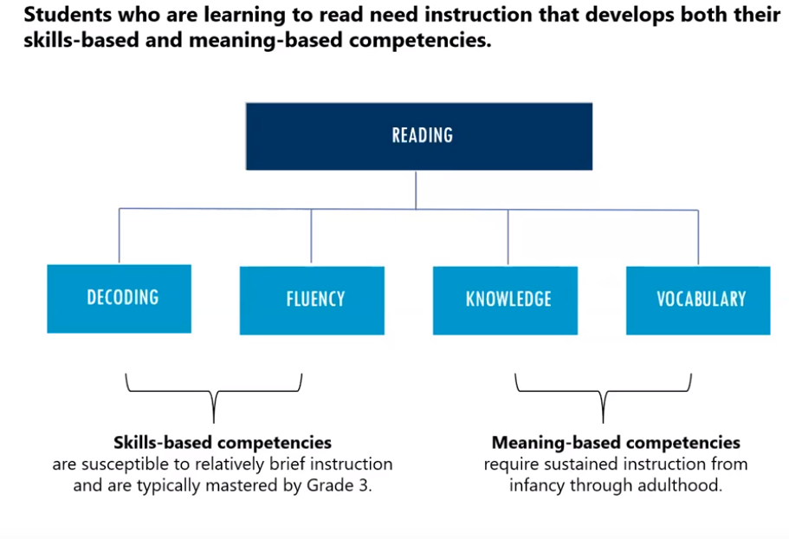

Notes:
Lead for Literacy Memo 4, Fall 2012: https://langlit.gse.harvard.edu/files/lesaux/files/04literacy_unpacked_langlit.pdf Students who are learning to read need instruction that develops both their skills-based and meaning-based competencies.
This graph represents the two parts of reading that are really essential for students to become proficient readers. They need to be proficient in skills-based competencies shown on the left-hand side which includes decoding and fluency and meaning based competencies shown on the right-hand side which includes knowledge and vocabulary. It’s important that we get good at identify the major purpose of our instruction- is it skills-based or meaning based because there are very different approaches for getting at both of these things.
Once we identify if a lesson purpose is skills-based or meaning-based we can become more strategic and intentional with our time during the lesson.

Slide 4
Skills-Based Competencies
Strategically designed
Explicitly taught and practiced
Carefully sequenced
Frequent, built-in opportunities to assess student progress and adjust instruction accordingly
Opportunities to work with letter/sound associations
Phonological processing time and space
Frequent/differentiated opportunities to practice Oral Reading Fluency
More exposures and experiences for students who are not proficient
Notes:
Skills-based instruction supports decoding and fluency. As you read through this list you will see direct connections to the ELA Foundational Skills Standards.

Slide 5
Meaning-Based Competencies
Knowledge and vocabulary rich texts
Mindful and planned read aloud
Rich texts as a source of deep learning
Study of sentence structure
Complex text with scaffolding for understanding
Evidence-based writing
Volume of text (some choice)
50% informational text, 50% literary text
Notes:
Meaning-based instruction supports knowledge building and vocabulary. As you read through this list you will see direct connections to the ELA Reading, Writing, Language and Speaking and Listening Standards.

Slide 6
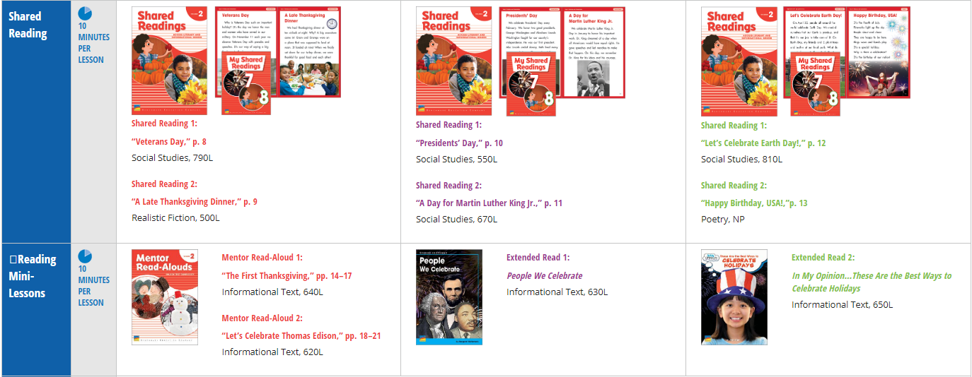
Notes:
Now we’re going to practice identifying if a lesson purpose supports skills-based or meaning based competencies. To do this we’ll use Benchmark Advance Kindergarten Unit 7. You can see the text used across the three week unit in the Shared Reading and Reading Mini-Lessons Components at a Glance. Week 1 is shown in the first column, week 2, the second column and week 3 in the last column.

Slide 7

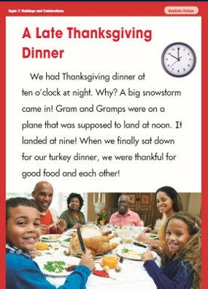
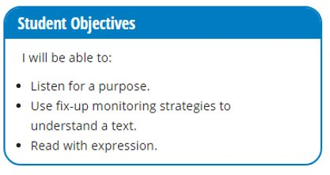
Kindergarten Unit 7 TRS
Shared Reading Lesson, pg. 27
RL.K.3 With prompting and support, identify characters, settings, and major events in a story. RF.K.1a follow words from left to right, top to bottom, and page by page. RF.K.4 Read emergent-reader texts with purpose and understanding. SL.K.3 Ask and answer questions in order to seek help, get information, or clarify something that is not understood.
Notes:
Now we’re going to look at a specific Shared Reading Lesson on page 27 of your Kindergarten Unit 7 TRS. On this slide you will see a sample of the text titled, A Late Thanksgiving. It is a realistic fiction text, 500 Lexile level. This text level falls at the beginning of the 2nd-3rd grade Common Core Text Complexity Grade Band meaning that this text is at the easier end of what second and third graders should be able to read independently. Something to consider is that this text will be read aloud multiple times by the kindergarten teacher during instruction. Thus, this text would be considered on the lower end of text complexity. You will also see the aligned standards and objectives listed below. Take a moment to pause and read over all three of these things on the slide.

Slide 8
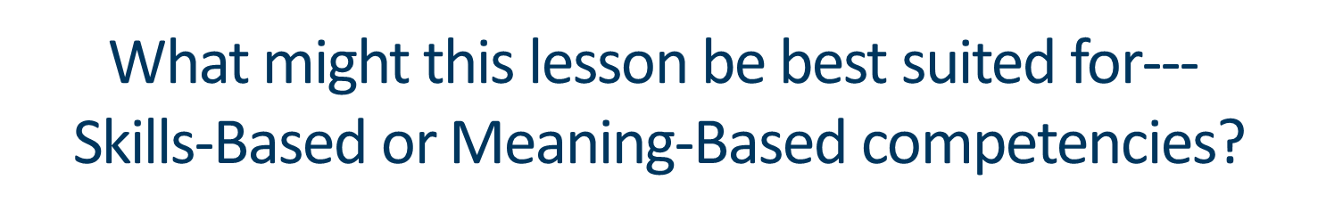

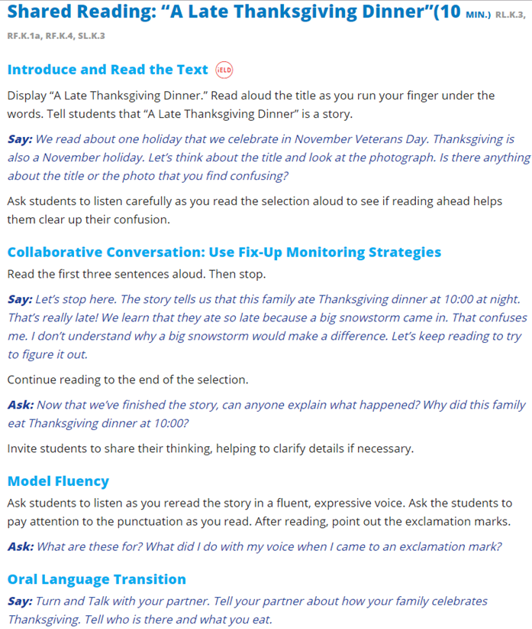
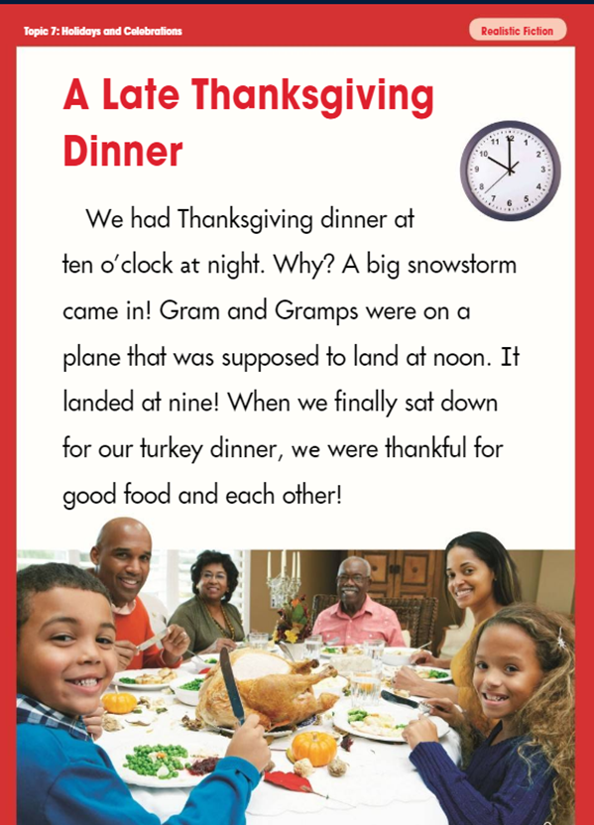
Notes:
Now read through the lesson on page 27. What might this lesson be best suited for– skills based or meaning based competencies?

Slide 9
Now what?
What might this text, A Late Thanksgiving be best suited for--- teaching skills-based or meaning-based competencies?
Based on the purpose you identified in the text, is there anything you could bolster or remove to get at the purpose and allow students enough practice time?
Notes:
When we try to teach both skills and meaning based instruction in a short 10 minute lesson it is difficult to focus on the main purpose of the lesson. Let’s see how we can put this understanding into practice with this shared reading lesson.
In this is a shared reading lesson with a lower level complexity text. The purpose of this lesson is best suited for skills-based competencies. Skills-based competencies include decoding and fluency. Based on that knowledge I would recommend spending the majority of the time practicing Oral Reading Fluency. This part of the lesson corresponds with the “Model Fluency” section of the lesson. It also aligns with the Standard RF.K.4 Read emergent-reader texts with purpose and understanding and the objective Read with expression. At the beginning of the lesson you may quickly ask one or two questions to make sure that students are using the text to build a bit of knowledge. For example you may ask the question, Is there anything about the title or the photo that you find confusing because it is important knowledge in the text that we want to reinforce but you could do this very quickly and move on to the skills practice. I would recommend skipping the Fix-Up Monitoring Strategies unless you embed some decoding practice. Otherwise, this part of the lesson as written in the TRS supports more meaning-based instruction and may be more powerful to pose these types of questions on a more complex text.

Slide 10
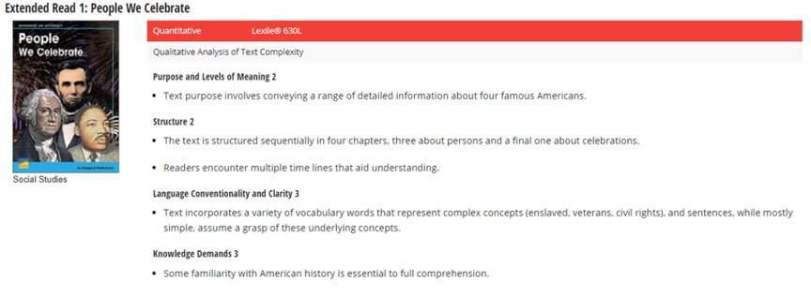
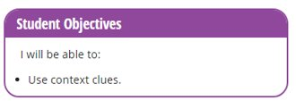
Kindergarten Unit 7 TRS
Extended Read 1 Mini-Lesson, pg. 59
RI.K.4 With prompting and support, ask and answer questions about unknown words in a text. L.K.4 Determine or clarify the meaning of unknown and multiple-meaning words and phrases based on kindergarten reading and content.
Notes:
Let’s try that same process again. Now we’re going to look at a specific Extended Read 1 Mini-Lesson on page 59 of your Kindergarten Unit 7 TRS. On this slide you will see the Quantitative and Qualitative Analysis of Text Complexity for the text titled, People We Celebrate. Take a closer look at this graphic on the bottom of page 40 in your TRS. It is an informational text, 630 Lexile level. This text level falls in the middle of the 2nd-3rd grade Common Core Text Complexity Grade Band meaning that this text is more complex than A Late Thanksgiving. The Total QM is 10 with Substantial Complexity. The most complex areas are the language conventionality and clarity as well as the knowledge demands. On this slide you will also see the aligned standards and objectives listed below the standards. Take a moment to pause and read over all three of these things on the slide.

Slide 11


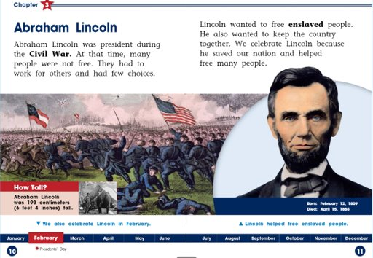
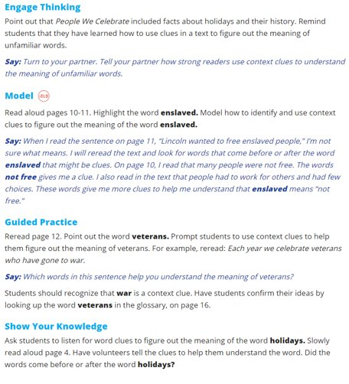
Informational Text, 630L
Notes:
Now read through the lesson on page 59. What might this lesson be best suited for– skills based or meaning based competencies?

Slide 12
Now what?
What might this text, Abraham Lincoln be best suited for--- teaching skills-based or meaning-based competencies?
Based on the purpose you identified in the text, is there anything you could bolster or remove to get at the purpose and allow students enough practice time?
Notes:
Again, it’s important to determine the purpose of a lesson to best support focused instruction.
In this is a extended read 1 lesson the purpose of this lesson is best suited for meaning-based competencies. The text complexity is substantial so will want to spend the majority of the time grappling with building knowledge and vocabulary through rich text-based questions and discussion. Based on that knowledge I would recommend implementing the entirety of this lesson in the TRS. The Engage Thinking, Model, Guided Practice and Show your Knowledge lesson components all build knowledge and vocabulary.

Slide 13
We prioritize instructional time by intentionally focusing on either
skills-based or meaning-based competencies based on the specific demands of the text.

Slide 14


Slide 15
Thank you for your time!
Kacey Edgington
Kedgington@washoeschools.net.

